Slide 1
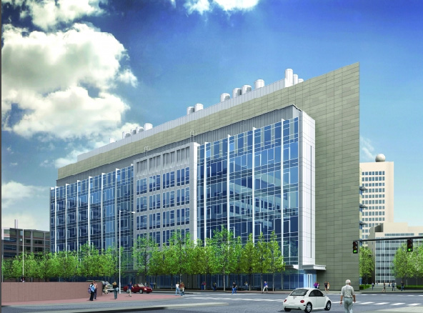
MIT Koch Institute for Integrative Cancer Research
Building Overview
Lighting Depth & Electrical Depth – Redesign
-Streetscape
-Gallery
-Flex Use Space
-Laboratory
Architectural Breadth– Southern façade shading
Electrical Depth – Copper/Aluminum feeder study
Project Team:
Owner: MIT
Architect: EllenZweig
CM: William A. Berry & Sons, Inc.
Structural: Lemessurier Consultants
HVAC & Electrical: BR+A Consulting Engineers, LLC
Lighting Consultant: LAM Partners, Inc.
Plumbing/FP: RW Sullivan Engineering
Civil: Nitsch Engineering, Inc.
Landscape Architect: Reed Hilderbrand Associates, Inc.
LEED Consultant: The Green Engineer, LLP
Telecommunications: Communications Design Group, Inc.
Andrew Moore
4.13.10
Rendering from the architect, EllenZweig

Slide 2
MIT Koch Institute for Integrative Cancer Research
Building Overview
Lighting Depth & Electrical Depth – Redesign
-Streetscape
-Gallery
-Flex Use Space
-Laboratory
Architectural Breadth– Southern façade shading
Electrical Depth – Copper/Aluminum feeder study
Size:
354,000 GSF
7 levels above grade
1 levels below grade
Construction:
Completion: 2010
Cost: ~ $190 million
Functions:
Cancer Research - Cellular Biology
- Molecular Genetics
- Engineering
Lab Support
Vivarium
Conference Facilities
Meeting Spaces
Cafeteria
Offices
Administrative Functions

Slide 3
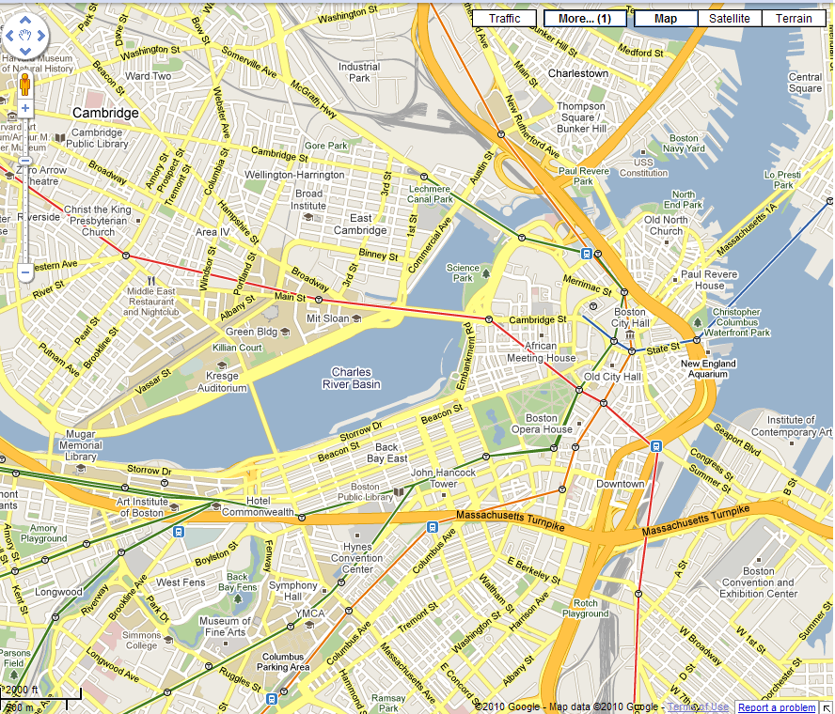
MIT Koch Institute for Integrative Cancer Research
Building Overview
Lighting Depth & Electrical Depth – Redesign
-Streetscape
-Gallery
-Flex Use Space
-Laboratory
Architectural Breadth– Southern façade shading
Electrical Depth – Copper/Aluminum feeder study
Functions:
Cancer Research - Cellular Biology
- Molecular Genetics
- Engineering
Lab Support
Vivarium
Conference Facilities
Meeting Spaces
Cafeteria
Offices
Administrative Functions
Koch Institute
Image courtesy Google Maps

Slide 4
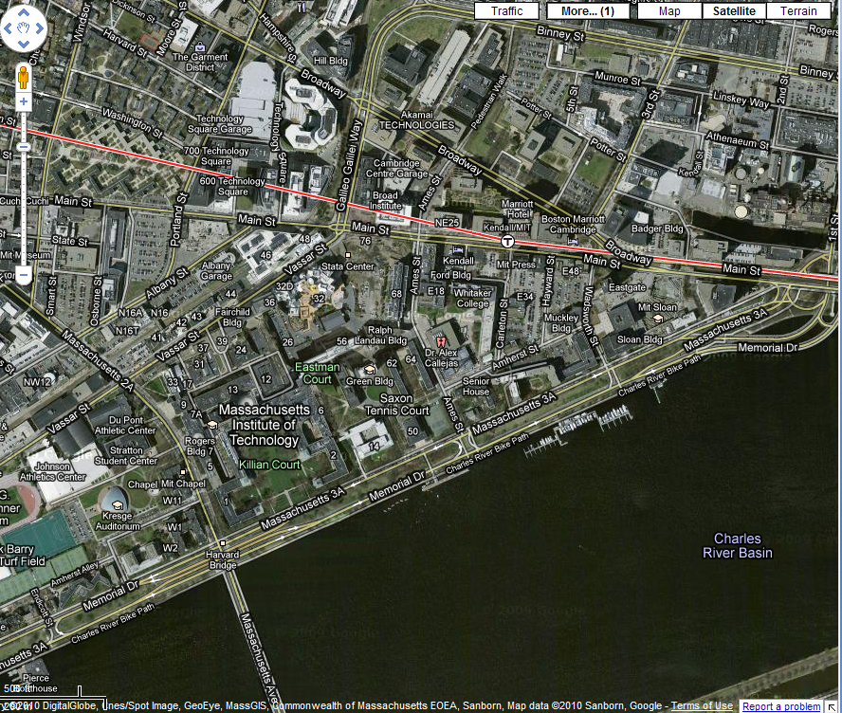
MIT Koch Institute for Integrative Cancer Research
Building Overview
Lighting Depth & Electrical Depth – Redesign
-Streetscape
-Gallery
-Flex Use Space
-Laboratory
Architectural Breadth– Southern façade shading
Electrical Depth – Copper/Aluminum feeder study
Koch Institute
Koch Institute
Image courtesy Google Maps
Image courtesy Google Maps

Slide 5
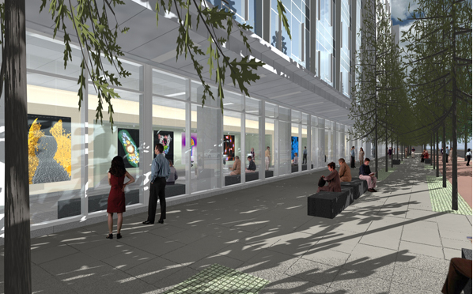
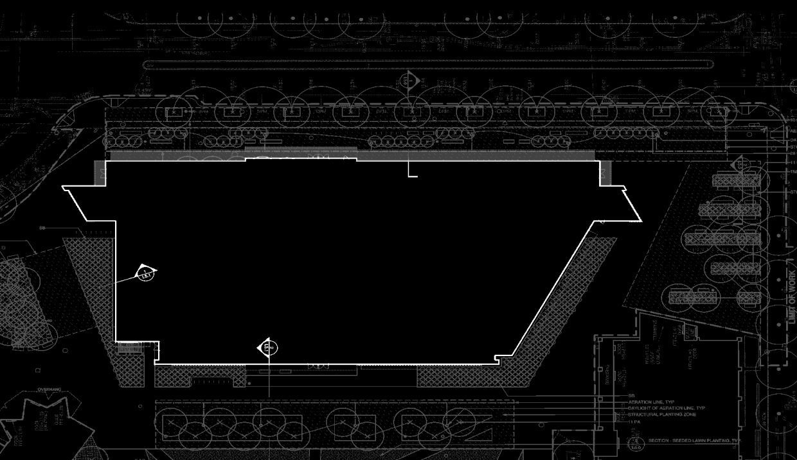
MIT Koch Institute for Integrative Cancer Research
Building Overview
Lighting Depth & Electrical Depth – Redesign
-Streetscape
-Gallery
-Flex Use Space
-Laboratory
Architectural Breadth– Southern façade shading
Electrical Depth – Copper/Aluminum feeder study
Rendering from the architect, EllenZweig

Slide 6
MIT Koch Institute for Integrative Cancer Research
Building Overview
Lighting Depth & Electrical Depth – Redesign
-Streetscape
-Gallery
-Flex Use Space
-Laboratory
Architectural Breadth– Southern façade shading
Electrical Depth – Copper/Aluminum feeder study
Goals:
  Compliment the adjacent Stata Center
  Provide a pathway along Main Street
  Compliment the adjacent Gallery space
  Enhance focal points
    Main Entrance
    Side Entrances

Slide 7
MIT Koch Institute for Integrative Cancer Research
Building Overview
Lighting Depth & Electrical Depth – Redesign
-Streetscape
-Gallery
-Flex Use Space
-Laboratory
Architectural Breadth– Southern façade shading
Electrical Depth – Copper/Aluminum feeder study
Criteria:
  Illuminance
    Horizontal: 5 fc
    Vertical: 3 fc
  Light Pollution
    < 5% luminous flux > 90º from nadir
  Lighting Power Density
    Plaza area – 0.2 W/ft²
    Main entry – 30 W/lf
    Side entries – 20 W/lf
    Canopy – 1.25 W/ft²

Slide 8
MIT Koch Institute for Integrative Cancer Research
Building Overview
Lighting Depth & Electrical Depth – Redesign
-Streetscape
-Gallery
-Flex Use Space
-Laboratory
Architectural Breadth– Southern façade shading
Electrical Depth – Copper/Aluminum feeder study
Criteria:
  Illuminance
    Horizontal: 5 fc
    Vertical: 3 fc
  Light Pollution
    < 5% luminous flux > 90º from nadir
  Lighting Power Density
    Plaza area – 0.2 W/ft²
    Main entry – 30 W/lf
    Side entries – 20 W/lf
    Canopy – 1.25 W/ft²
Dimensions:
  ~ 18000 ft²
  ~ 444 ft x 36.5 ft
  Front façade = 295’-5” long
Elements:
  Granite benches
  10 pin oak trees
  28 columnar ginkgo trees

Slide 9
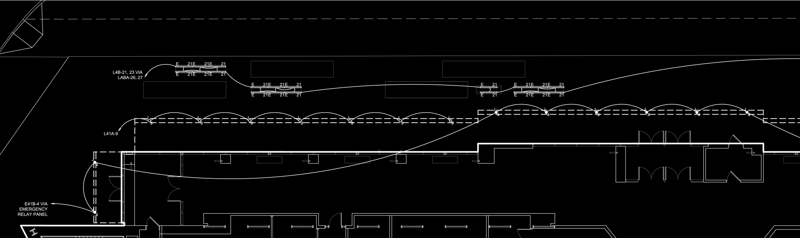
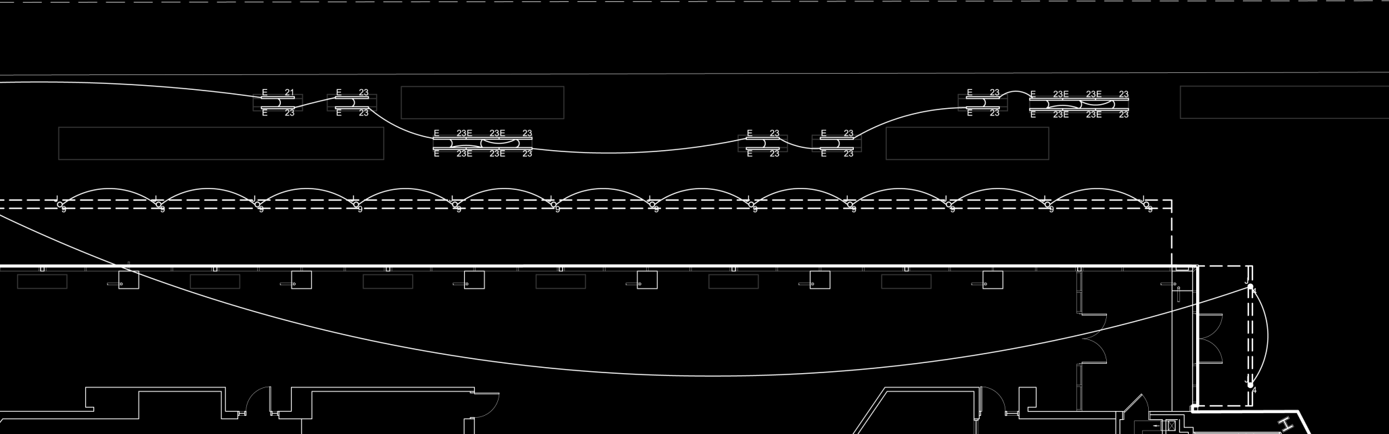
MIT Koch Institute for Integrative Cancer Research
Building Overview
Lighting Depth & Electrical Depth – Redesign
-Streetscape
-Gallery
-Flex Use Space
-Laboratory
Architectural Breadth– Southern façade shading
Electrical Depth – Copper/Aluminum feeder study

Slide 10
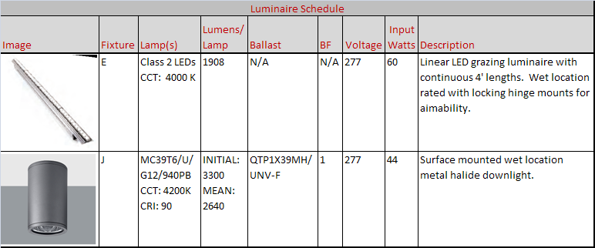
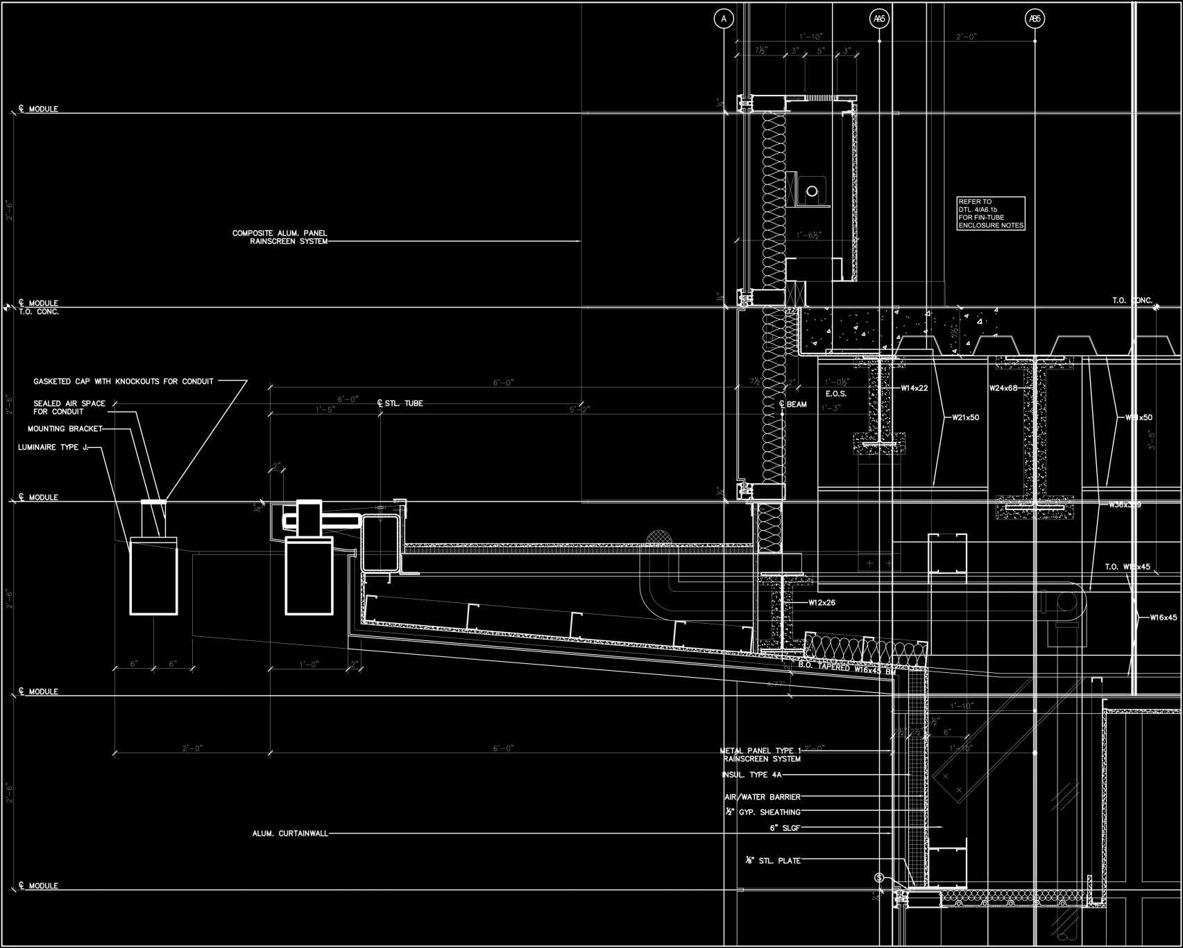
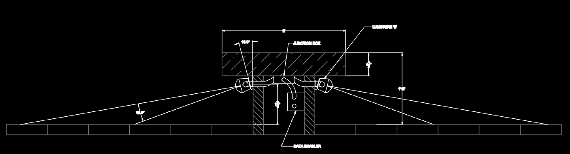
MIT Koch Institute for Integrative Cancer Research
Building Overview
Lighting Depth & Electrical Depth – Redesign
-Streetscape
-Gallery
-Flex Use Space
-Laboratory
Architectural Breadth– Southern façade shading
Electrical Depth – Copper/Aluminum feeder study

Slide 11
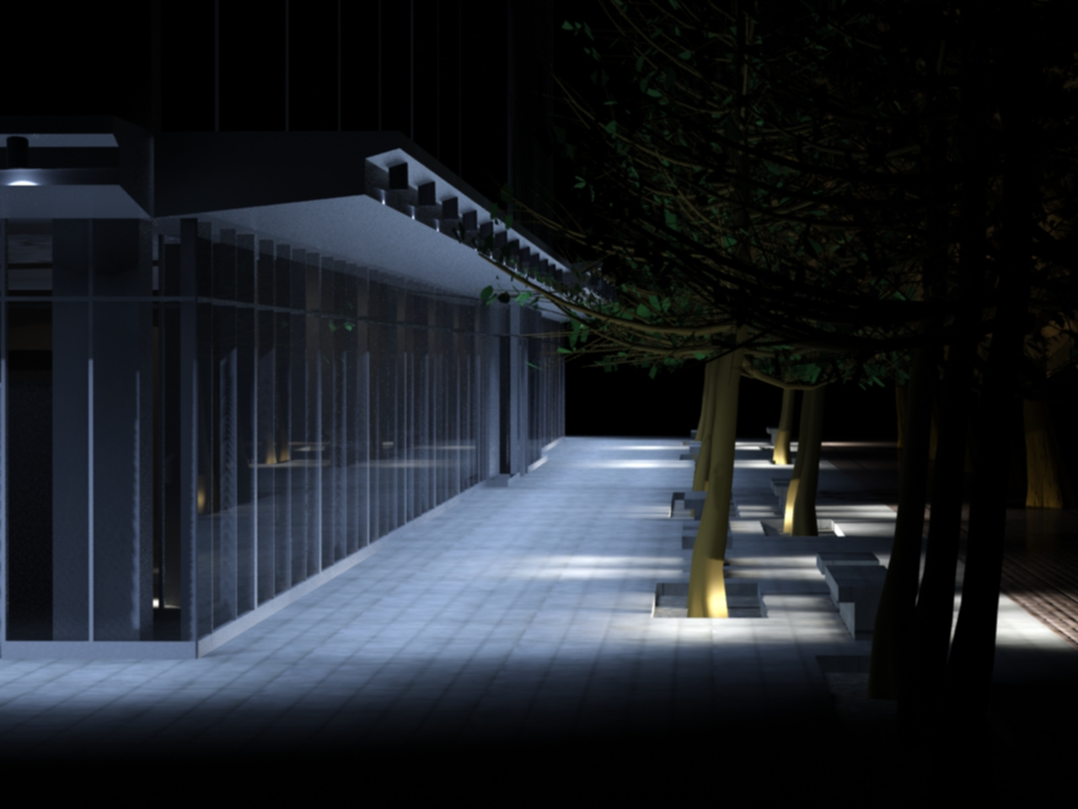
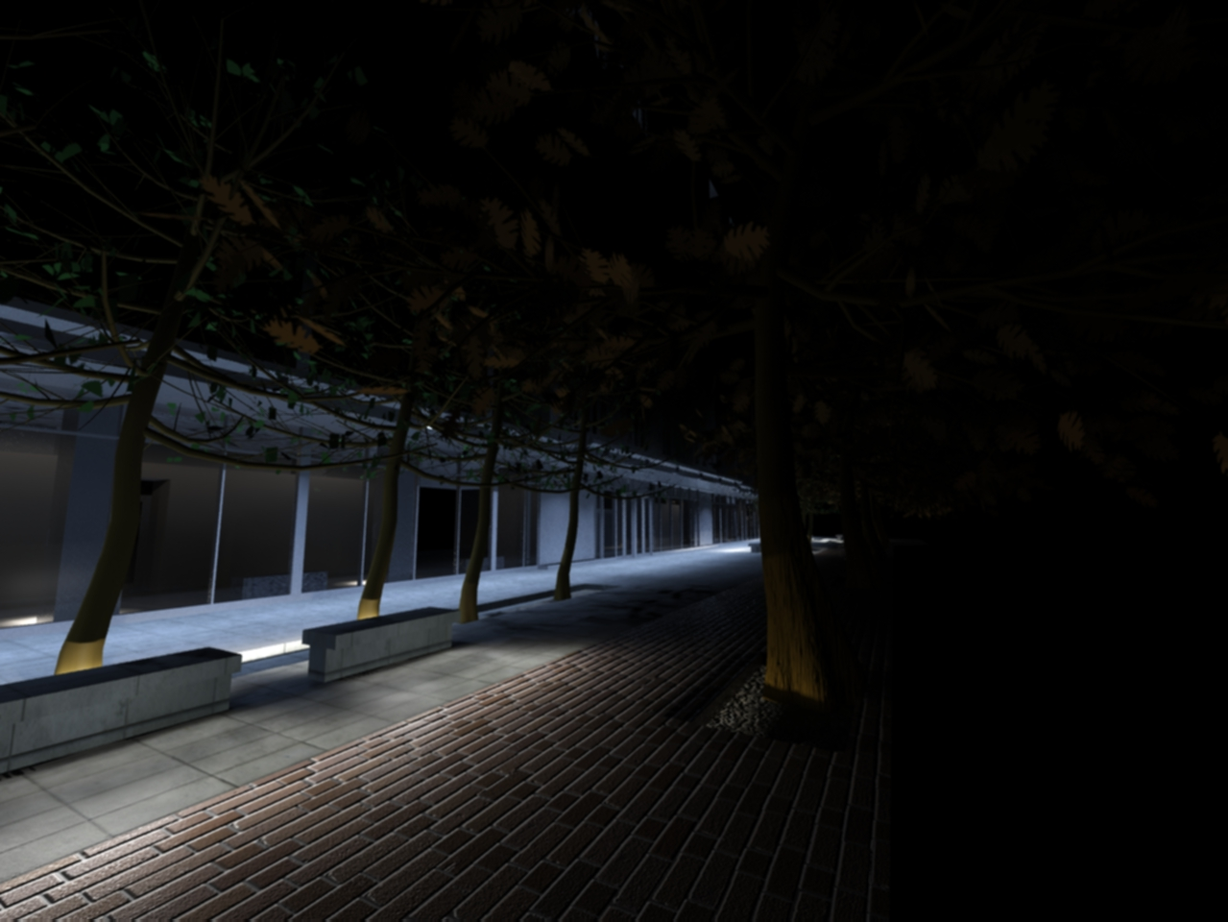
MIT Koch Institute for Integrative Cancer Research
Building Overview
Lighting Depth & Electrical Depth – Redesign
-Streetscape
-Gallery
-Flex Use Space
-Laboratory
Architectural Breadth– Southern façade shading
Electrical Depth – Copper/Aluminum feeder study

Slide 12
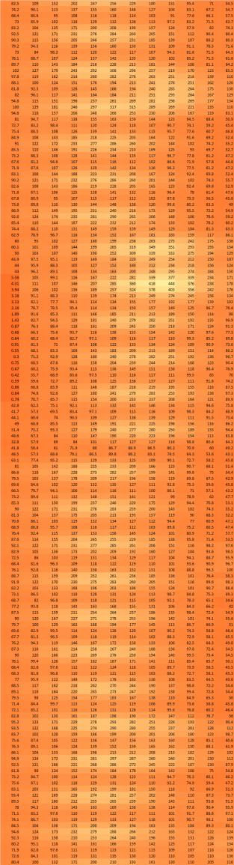
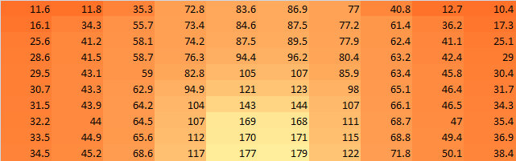
MIT Koch Institute for Integrative Cancer Research
Building Overview
Lighting Depth & Electrical Depth – Redesign
-Streetscape
-Gallery
-Flex Use Space
-Laboratory
Architectural Breadth– Southern façade shading
Electrical Depth – Copper/Aluminum feeder study
Performance:
  Illuminance
    Horizontal: 12.5 fc average
    Vertical: 6.46 fc average
  Light Pollution
    none of the luminous flux is emitted >90º from nadir
  Lighting Power Density
    Allowed power = 6667 W
    Design power = 3796 W

Slide 13
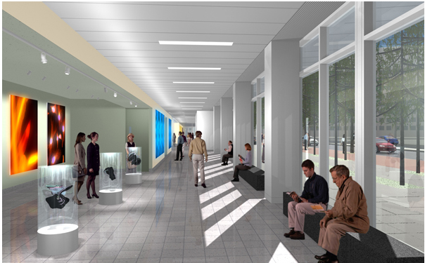
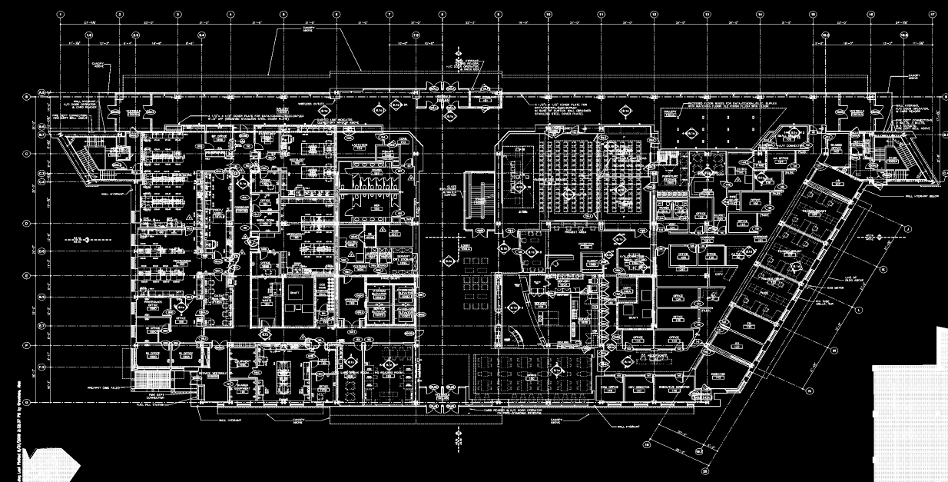
MIT Koch Institute for Integrative Cancer Research
Building Overview
Lighting Depth & Electrical Depth – Redesign
-Streetscape
-Gallery
-Flex Use Space
-Laboratory
Architectural Breadth– Southern façade shading
Electrical Depth – Copper/Aluminum feeder study
Rendering from the architect, EllenZweig

Slide 14
MIT Koch Institute for Integrative Cancer Research
Building Overview
Lighting Depth & Electrical Depth – Redesign
-Streetscape
-Gallery
-Flex Use Space
-Laboratory
Architectural Breadth– Southern façade shading
Electrical Depth – Copper/Aluminum feeder study
Goals:
  Provide flexibility for display area
  Properly illuminate vertical displays along south wall
  Provide daytime and night time scenes

Slide 15
MIT Koch Institute for Integrative Cancer Research
Building Overview
Lighting Depth & Electrical Depth – Redesign
-Streetscape
-Gallery
-Flex Use Space
-Laboratory
Architectural Breadth– Southern façade shading
Electrical Depth – Copper/Aluminum feeder study
Criteria:
  Illuminance
    Horizontal: 10 fc
    Vertical: 3 fc
  Lighting Power Density
    1.1 W/ft²

Slide 16
MIT Koch Institute for Integrative Cancer Research
Building Overview
Lighting Depth & Electrical Depth – Redesign
-Streetscape
-Gallery
-Flex Use Space
-Laboratory
Architectural Breadth– Southern façade shading
Electrical Depth – Copper/Aluminum feeder study
Criteria:
  Illuminance
    Horizontal: 10 fc
    Vertical: 3 fc
  Lighting Power Density
    1.1 W/ft²
Dimensions:
  ~ 2415 ft²
  ~ 133’-7” x 14’-1.5”
  Height = 12’-9.75”
  Display area = ~802 ft²
  6” drop ceiling in display area

Slide 17
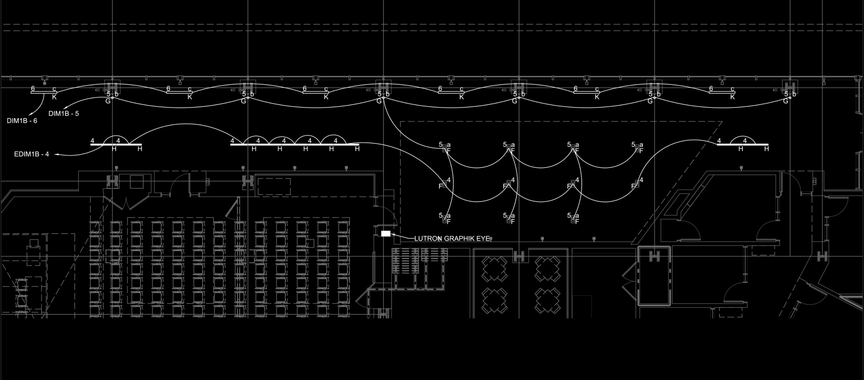
MIT Koch Institute for Integrative Cancer Research
Building Overview
Lighting Depth & Electrical Depth – Redesign
-Streetscape
-Gallery
-Flex Use Space
-Laboratory
Architectural Breadth– Southern façade shading
Electrical Depth – Copper/Aluminum feeder study
Dimensions:
  ~ 2415 ft²
  ~ 133’-7” x 14’-1.5”
  Display area = ~802 ft²

Slide 18
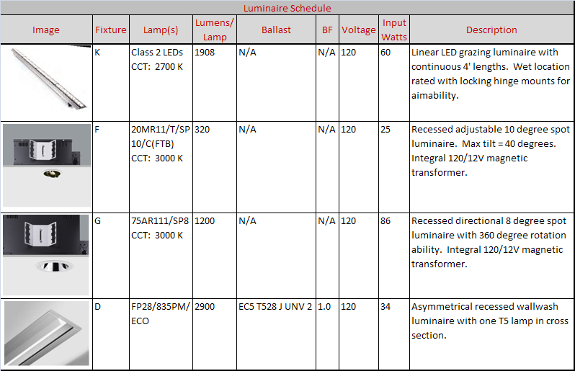
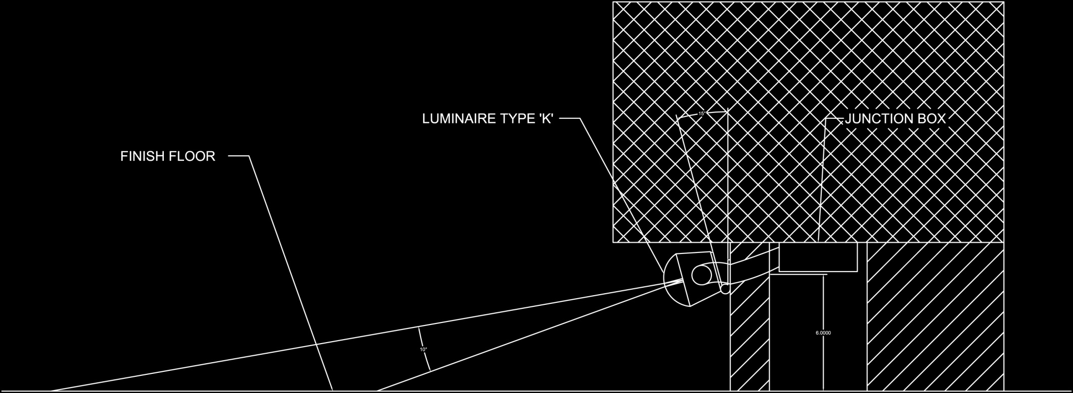
MIT Koch Institute for Integrative Cancer Research
Building Overview
Lighting Depth & Electrical Depth – Redesign
-Streetscape
-Gallery
-Flex Use Space
-Laboratory
Architectural Breadth– Southern façade shading
Electrical Depth – Copper/Aluminum feeder study

Slide 19
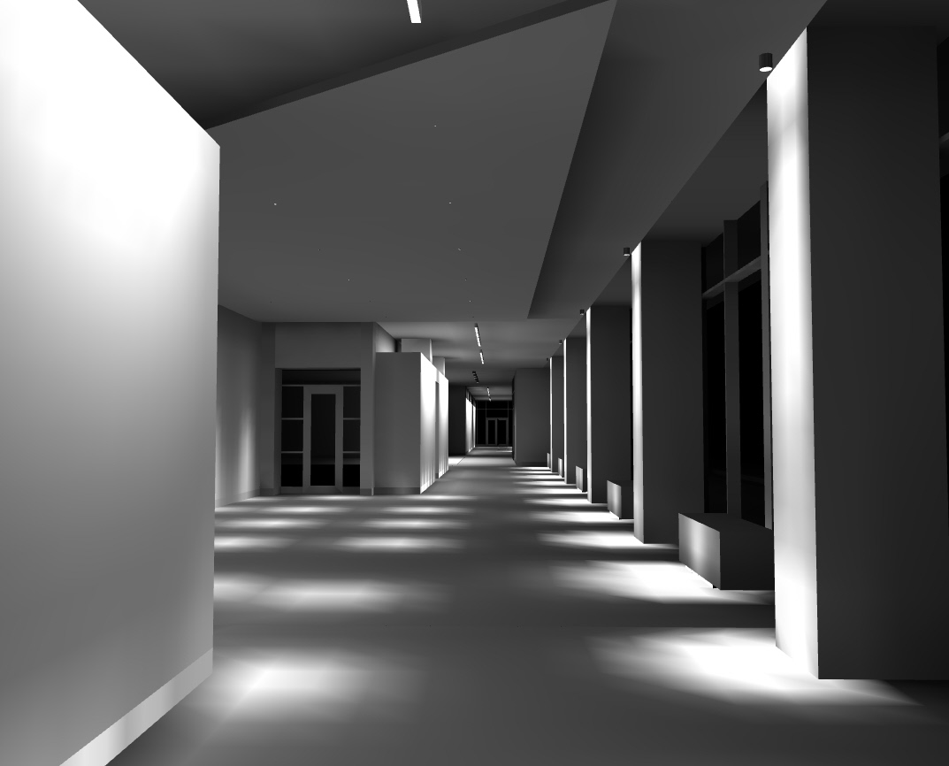
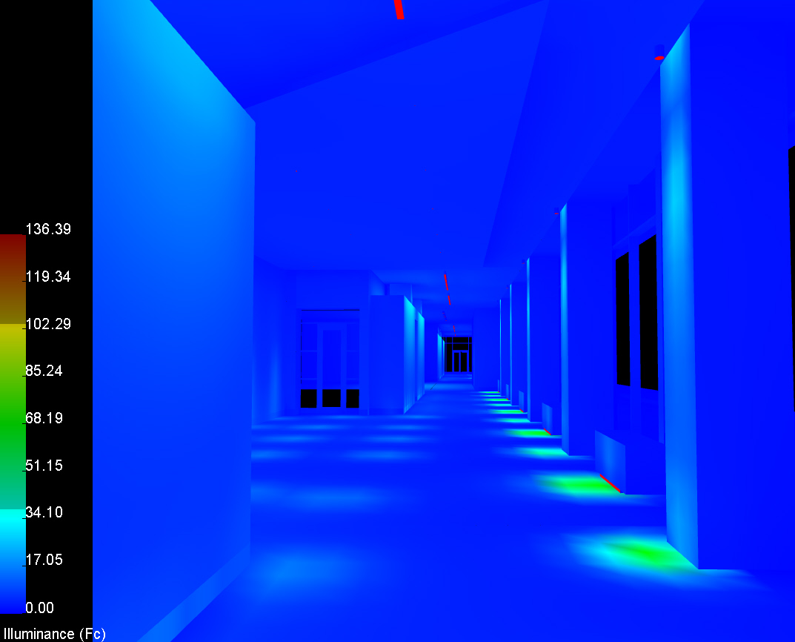
MIT Koch Institute for Integrative Cancer Research
Building Overview
Lighting Depth & Electrical Depth – Redesign
-Streetscape
-Gallery
-Flex Use Space
-Laboratory
Architectural Breadth– Southern façade shading
Electrical Depth – Copper/Aluminum feeder study

Slide 20
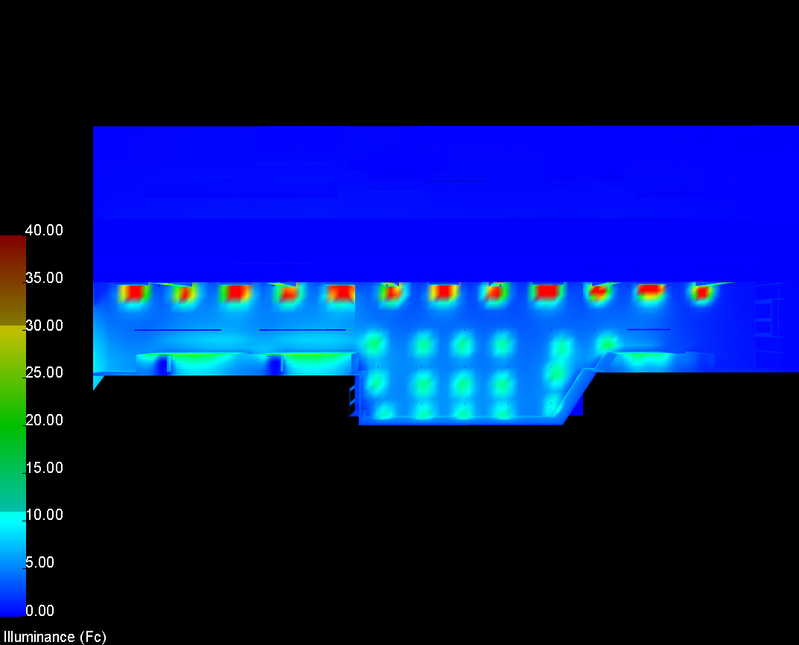
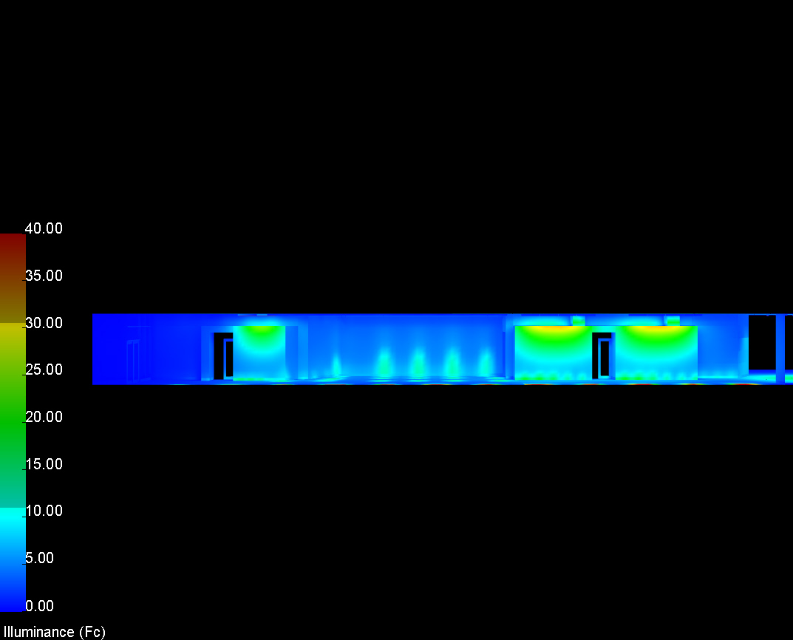
MIT Koch Institute for Integrative Cancer Research
Building Overview
Lighting Depth & Electrical Depth – Redesign
-Streetscape
-Gallery
-Flex Use Space
-Laboratory
Architectural Breadth– Southern façade shading
Electrical Depth – Copper/Aluminum feeder study

Slide 21
MIT Koch Institute for Integrative Cancer Research
Building Overview
Lighting Depth & Electrical Depth – Redesign
-Streetscape
-Gallery
-Flex Use Space
-Laboratory
Architectural Breadth– Southern façade shading
Electrical Depth – Copper/Aluminum feeder study
Performance:
  Illuminance
    Horizontal: 8.1fc average
    Vertical: 4.11 fc average
  Lighting Power Density
    Allowed power = 2656.5W
    Design power = 1457 W

Slide 22
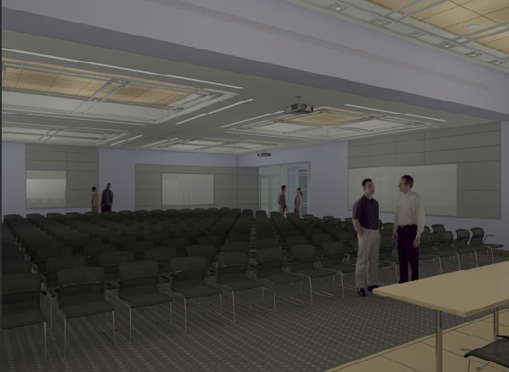
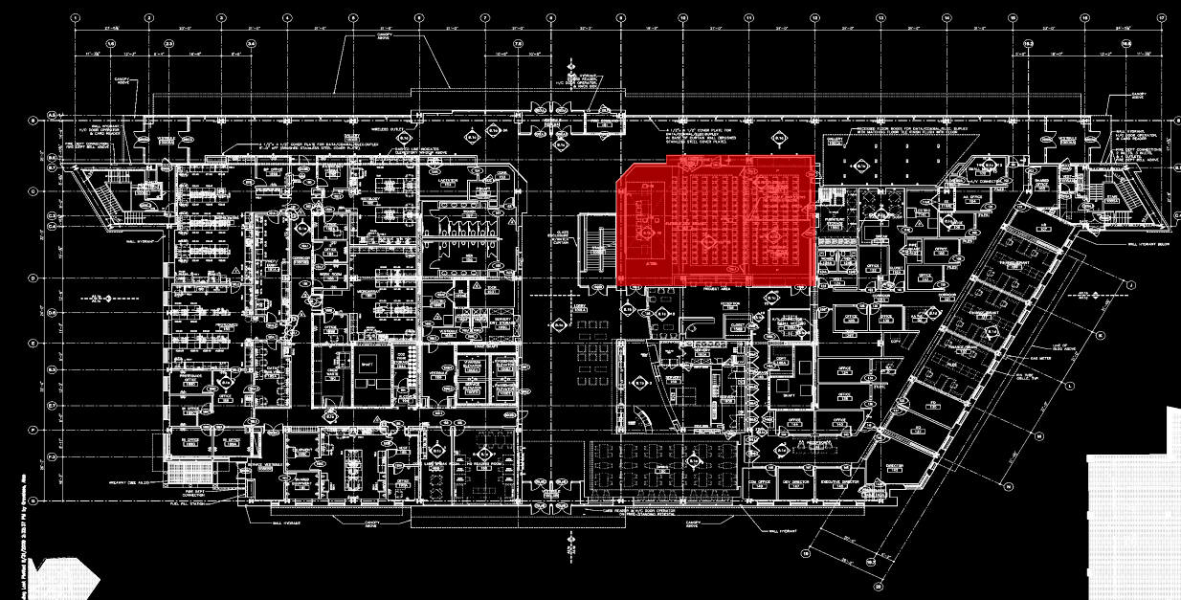
MIT Koch Institute for Integrative Cancer Research
Building Overview
Lighting Depth & Electrical Depth – Redesign
-Streetscape
-Gallery
-Flex Use Space
-Laboratory
Architectural Breadth– Southern façade shading
Electrical Depth – Copper/Aluminum feeder study
Rendering from the architect, EllenZweig

Slide 23
MIT Koch Institute for Integrative Cancer Research
Building Overview
Lighting Depth & Electrical Depth – Redesign
-Streetscape
-Gallery
-Flex Use Space
-Laboratory
Architectural Breadth– Southern façade shading
Electrical Depth – Copper/Aluminum feeder study
Goals:
  Provide a flexible lighting system for a variety of scenarios from presentation to social gathering
  Allow for the use of the dividers and conference settings in the space

Slide 24
MIT Koch Institute for Integrative Cancer Research
Building Overview
Lighting Depth & Electrical Depth – Redesign
-Streetscape
-Gallery
-Flex Use Space
-Laboratory
Architectural Breadth– Southern façade shading
Electrical Depth – Copper/Aluminum feeder study
Criteria:
  Illuminance
    Assembly:
      Horizontal: 10 fc
    Social
      Horizontal: 5 fc
      Vertical: 3 fc
    Conference
      Horizontal: 30 fc
      Vertical: 5 fc
  Lighting Power Density
    1.3 W/ft²

Slide 25
MIT Koch Institute for Integrative Cancer Research
Building Overview
Lighting Depth & Electrical Depth – Redesign
-Streetscape
-Gallery
-Flex Use Space
-Laboratory
Architectural Breadth– Southern façade shading
Electrical Depth – Copper/Aluminum feeder study
Criteria:
  Illuminance
    Assembly:
      Horizontal: 10 fc
    Social
      Horizontal: 5 fc
      Vertical: 3 fc
    Conference
      Horizontal: 30 fc
      Vertical: 5 fc
  Lighting Power Density
    1.3 W/ft²
Dimensions:
  ~ 2497 ft²
  ~ 57’-8” x 43’-9”
  Height = 11’-3” in back and
  14’-3” in front
  1’-6.75” recesses in ceilings

Slide 26
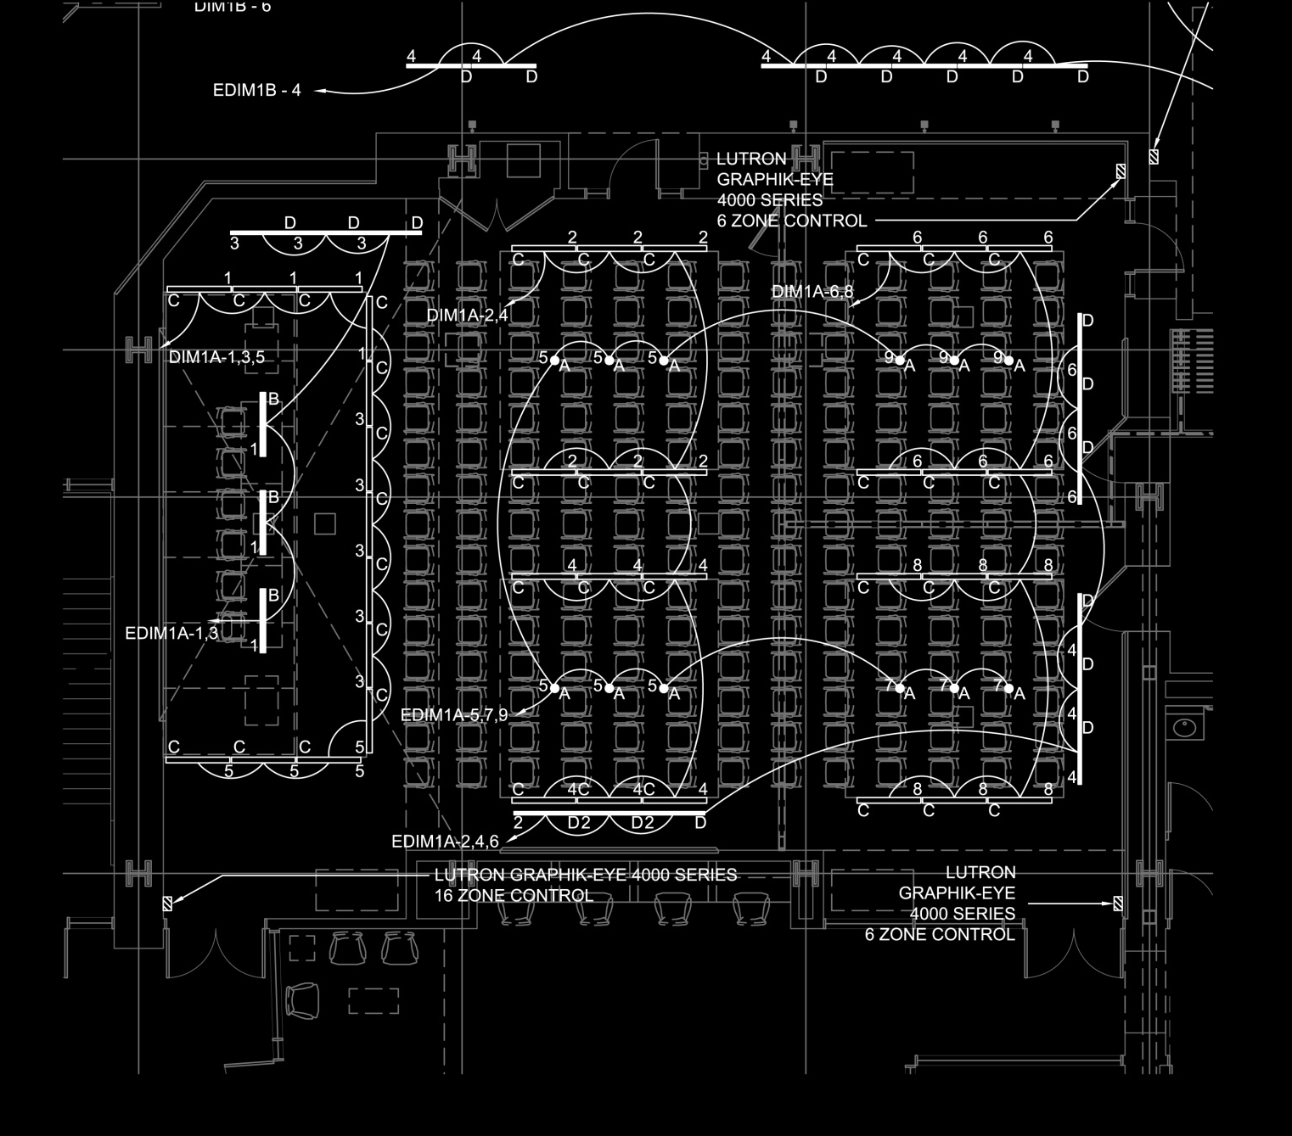
MIT Koch Institute for Integrative Cancer Research
Building Overview
Lighting Depth & Electrical Depth – Redesign
-Streetscape
-Gallery
-Flex Use Space
-Laboratory
Architectural Breadth– Southern façade shading
Electrical Depth – Copper/Aluminum feeder study
Dimensions:
  ~ 2497 ft²
  ~ 57’-8” x 43’-9”
  Height = 11’-3” in back and
  14’-3” in front
  1’-6.75” recesses in ceilings

Slide 27
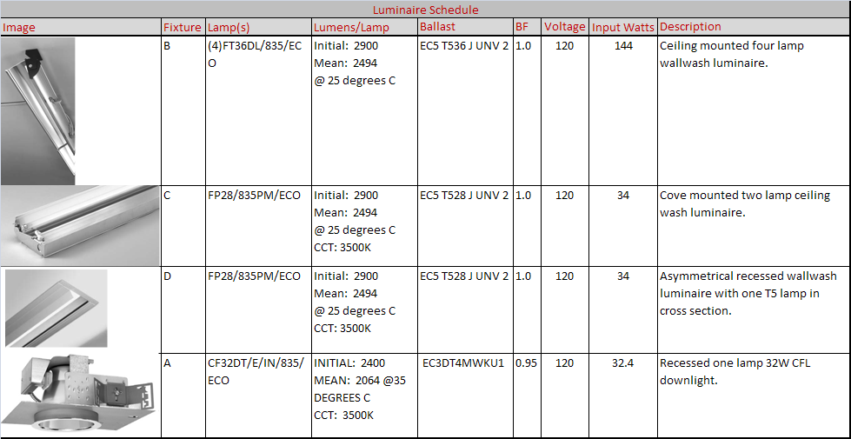
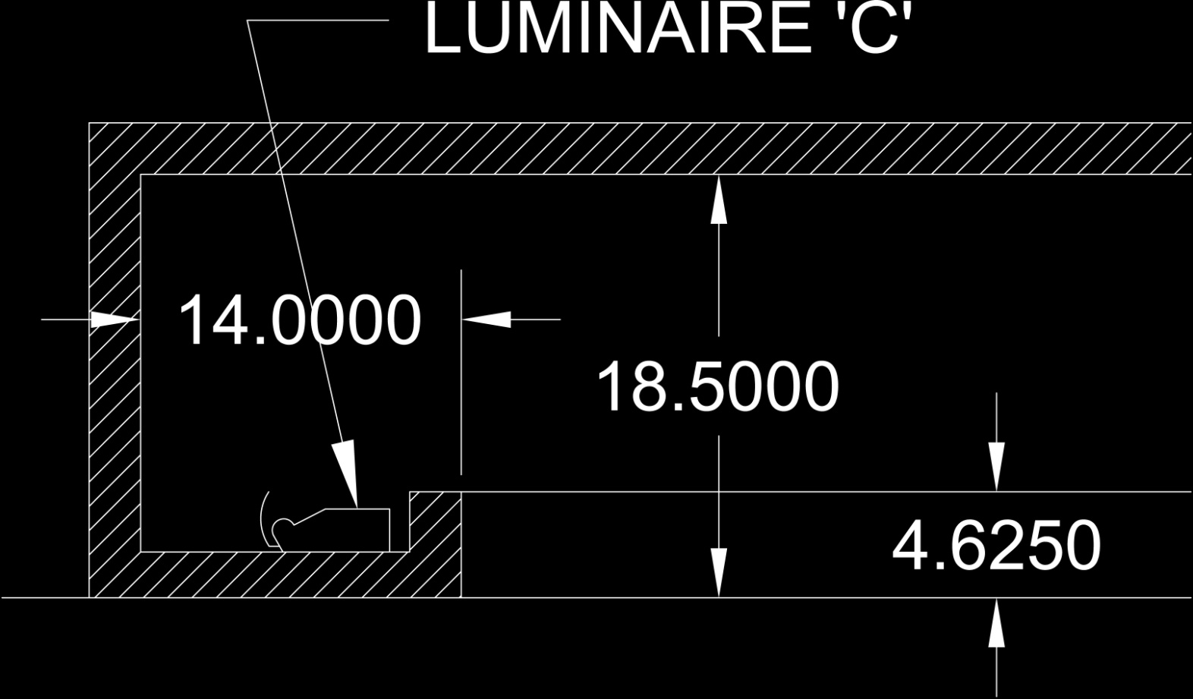
MIT Koch Institute for Integrative Cancer Research
Building Overview
Lighting Depth & Electrical Depth – Redesign
-Streetscape
-Gallery
-Flex Use Space
-Laboratory
Architectural Breadth– Southern façade shading
Electrical Depth – Copper/Aluminum feeder study

Slide 28
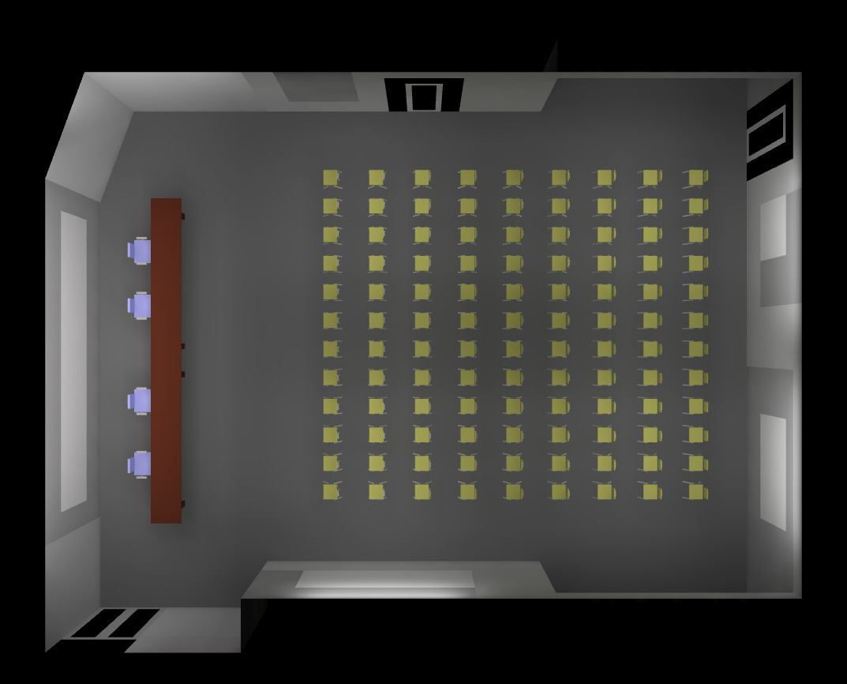
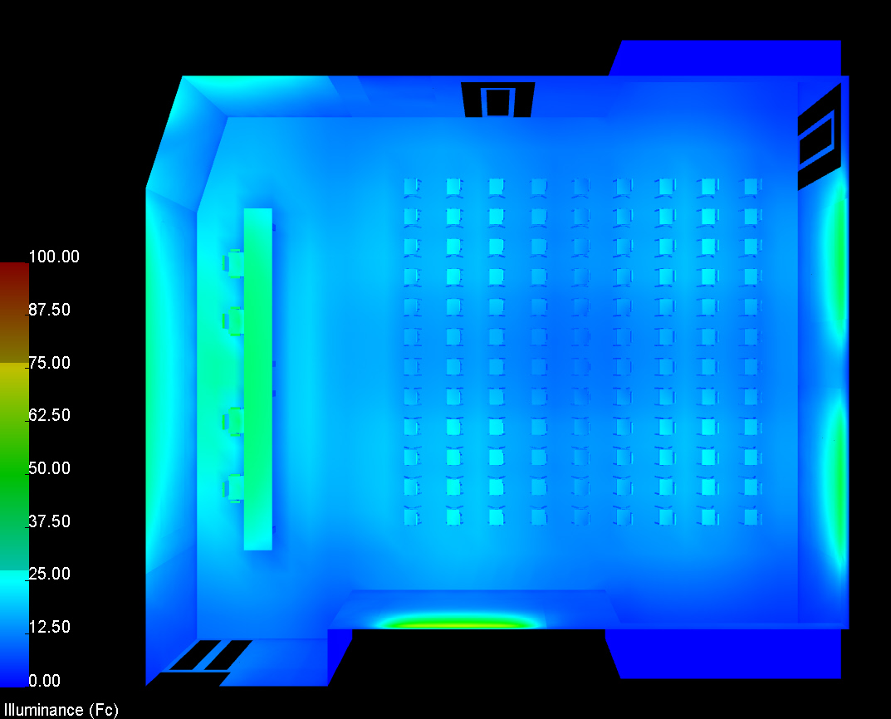
MIT Koch Institute for Integrative Cancer Research
Building Overview
Lighting Depth & Electrical Depth – Redesign
-Streetscape
-Gallery
-Flex Use Space
-Laboratory
Architectural Breadth– Southern façade shading
Electrical Depth – Copper/Aluminum feeder study

Slide 29
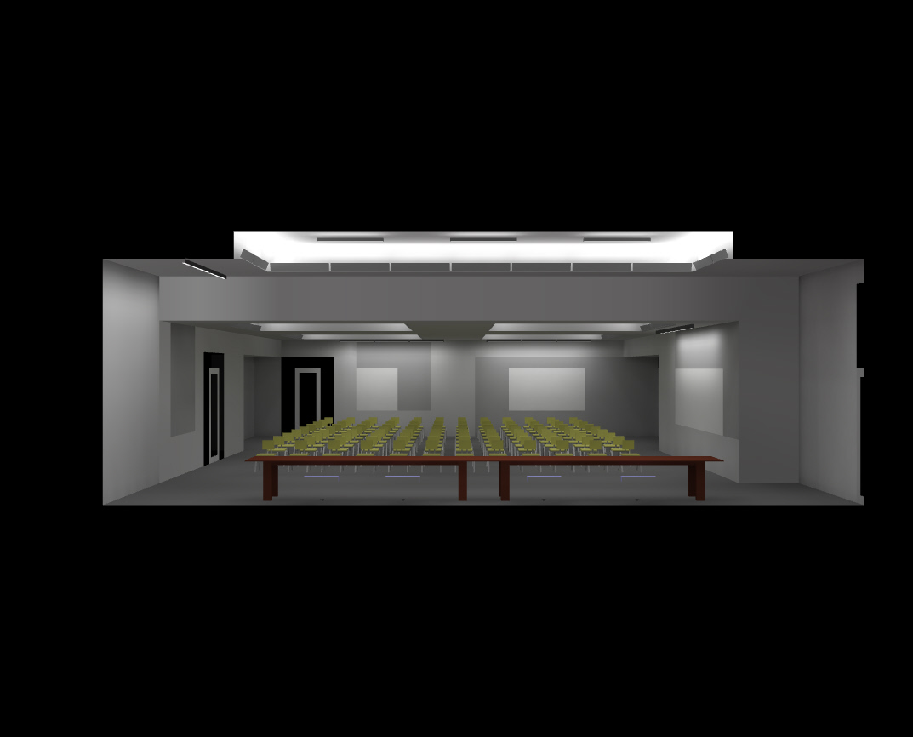
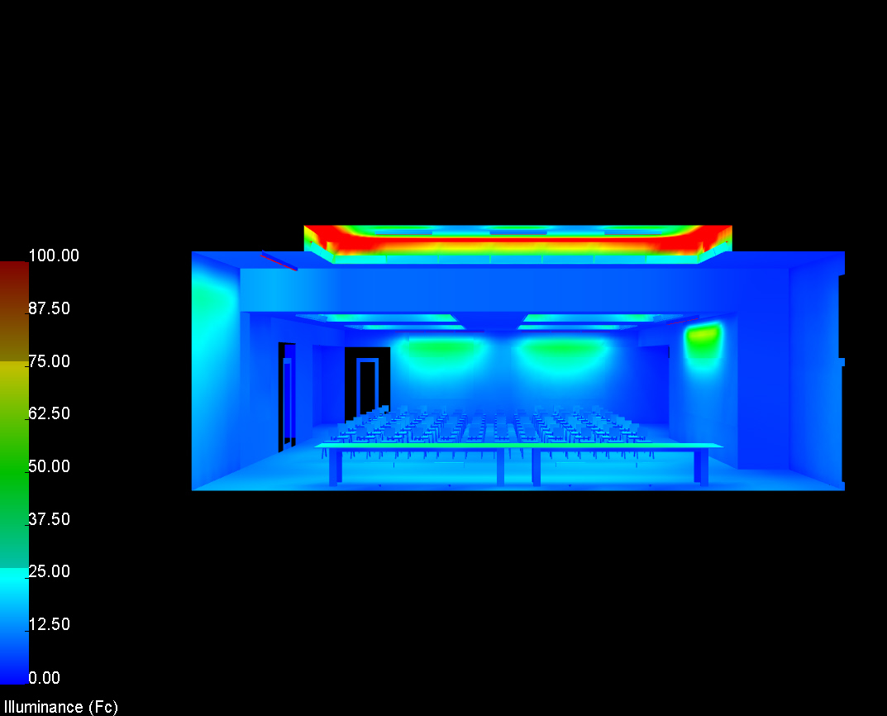
MIT Koch Institute for Integrative Cancer Research
Building Overview
Lighting Depth & Electrical Depth – Redesign
-Streetscape
-Gallery
-Flex Use Space
-Laboratory
Architectural Breadth– Southern façade shading
Electrical Depth – Copper/Aluminum feeder study

Slide 30
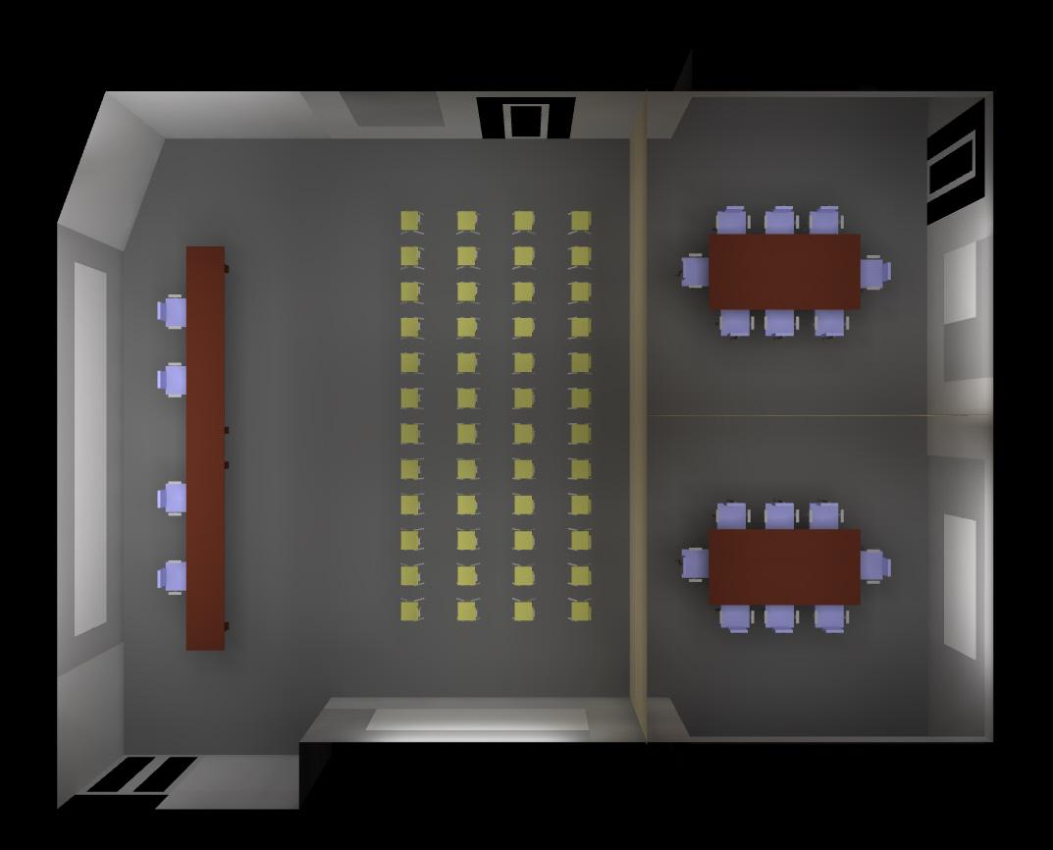
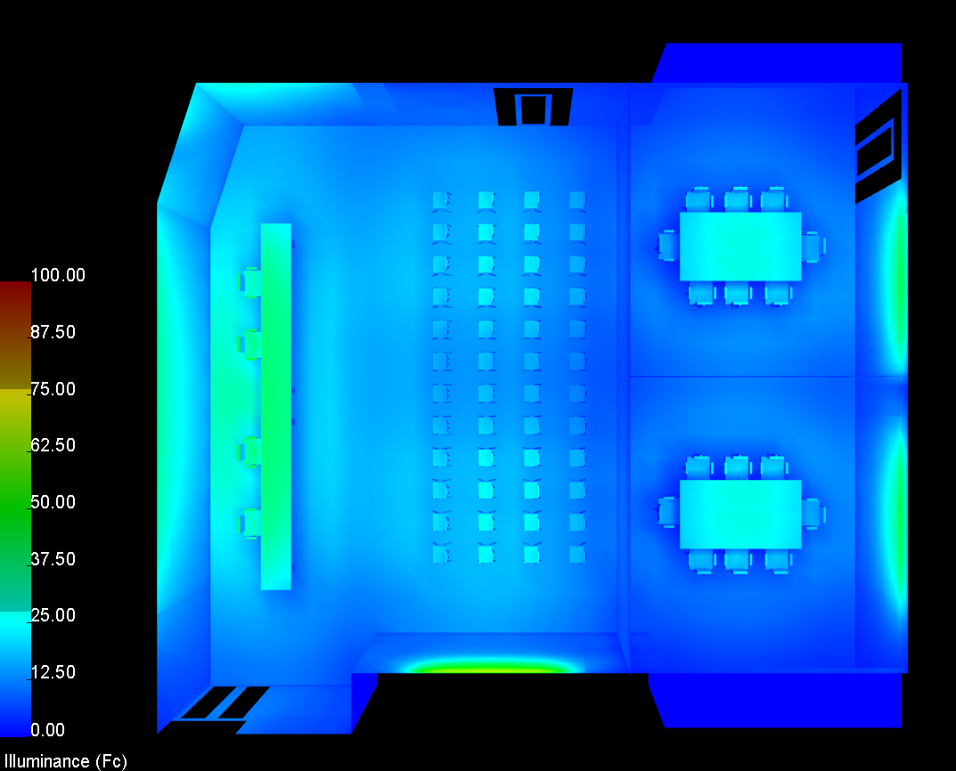
MIT Koch Institute for Integrative Cancer Research
Building Overview
Lighting Depth & Electrical Depth – Redesign
-Streetscape
-Gallery
-Flex Use Space
-Laboratory
Architectural Breadth– Southern façade shading
Electrical Depth – Copper/Aluminum feeder study

Slide 31
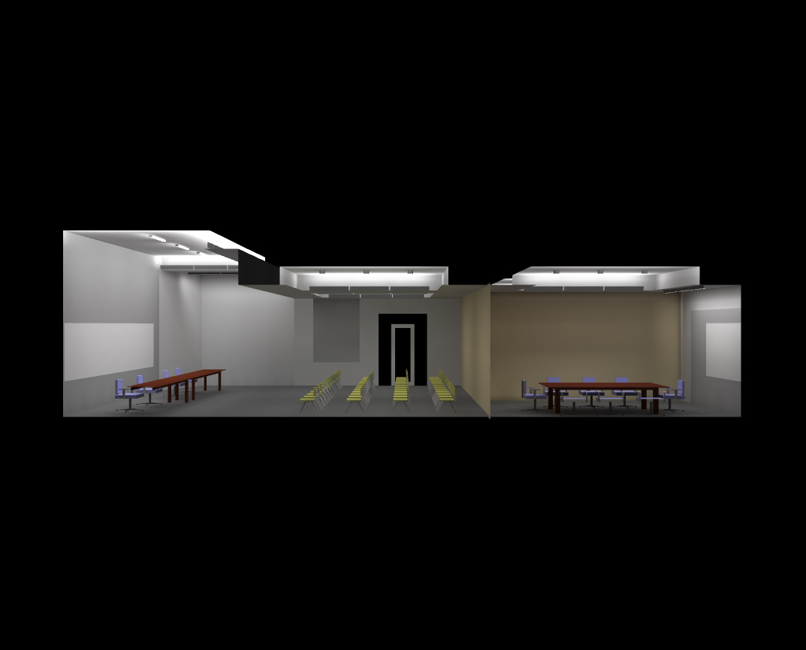
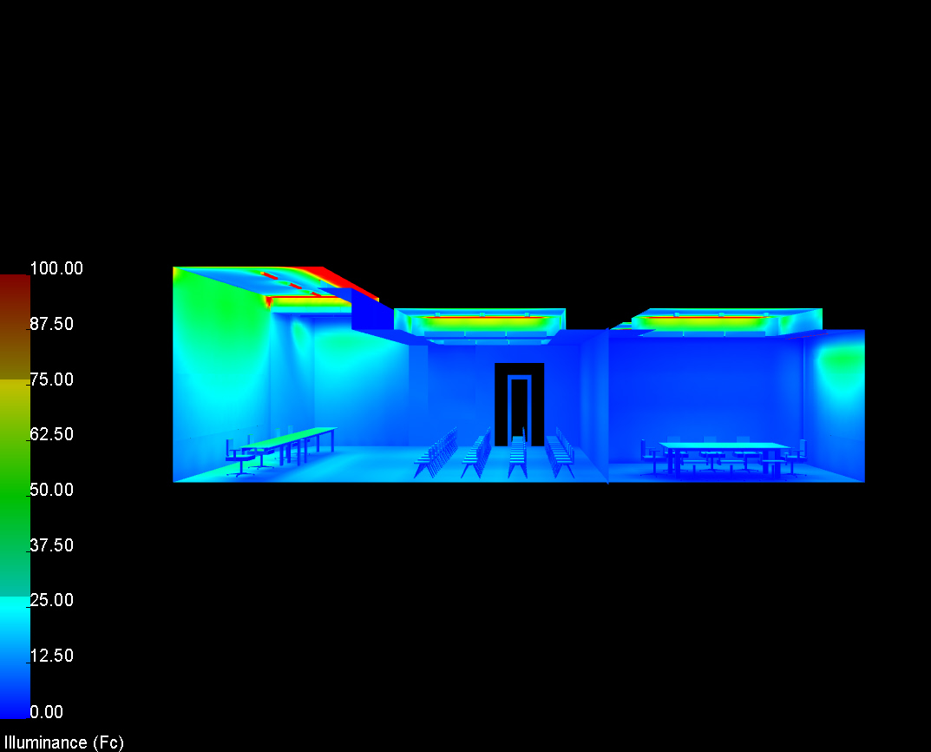
MIT Koch Institute for Integrative Cancer Research
Building Overview
Lighting Depth & Electrical Depth – Redesign
-Streetscape
-Gallery
-Flex Use Space
-Laboratory
Architectural Breadth– Southern façade shading
Electrical Depth – Copper/Aluminum feeder study

Slide 32
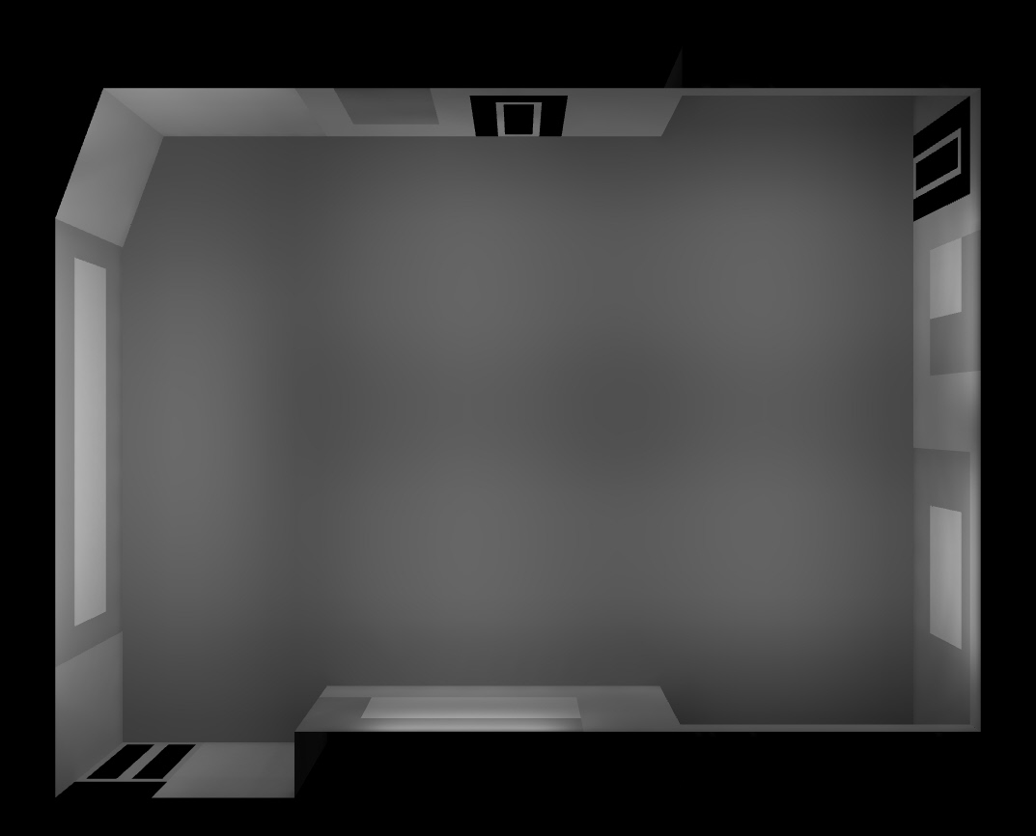
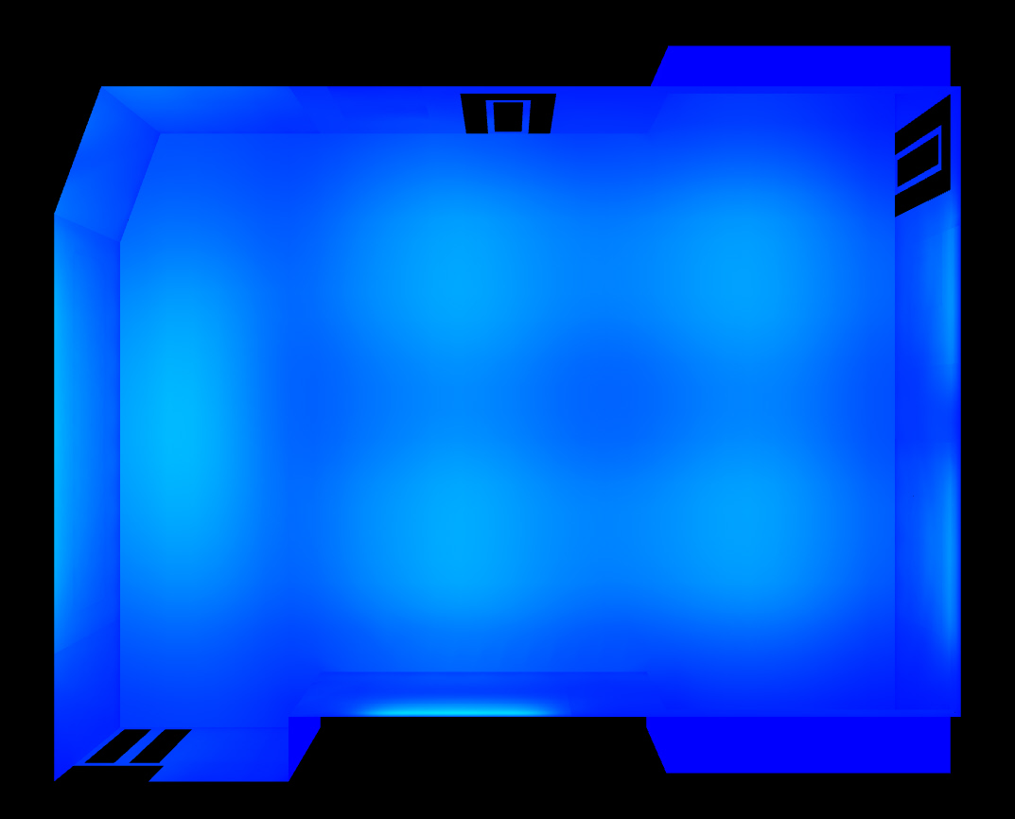
MIT Koch Institute for Integrative Cancer Research
Building Overview
Lighting Depth & Electrical Depth – Redesign
-Streetscape
-Gallery
-Flex Use Space
-Laboratory
Architectural Breadth– Southern façade shading
Electrical Depth – Copper/Aluminum feeder study

Slide 33
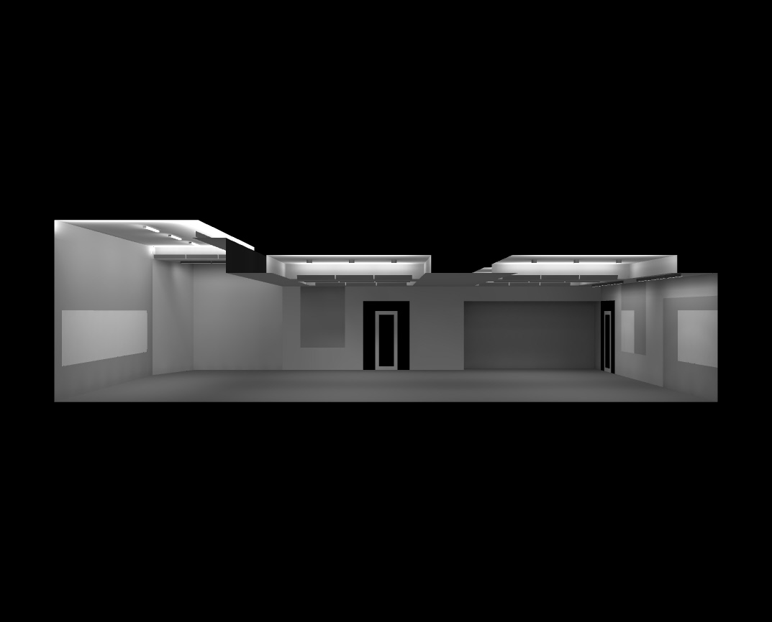
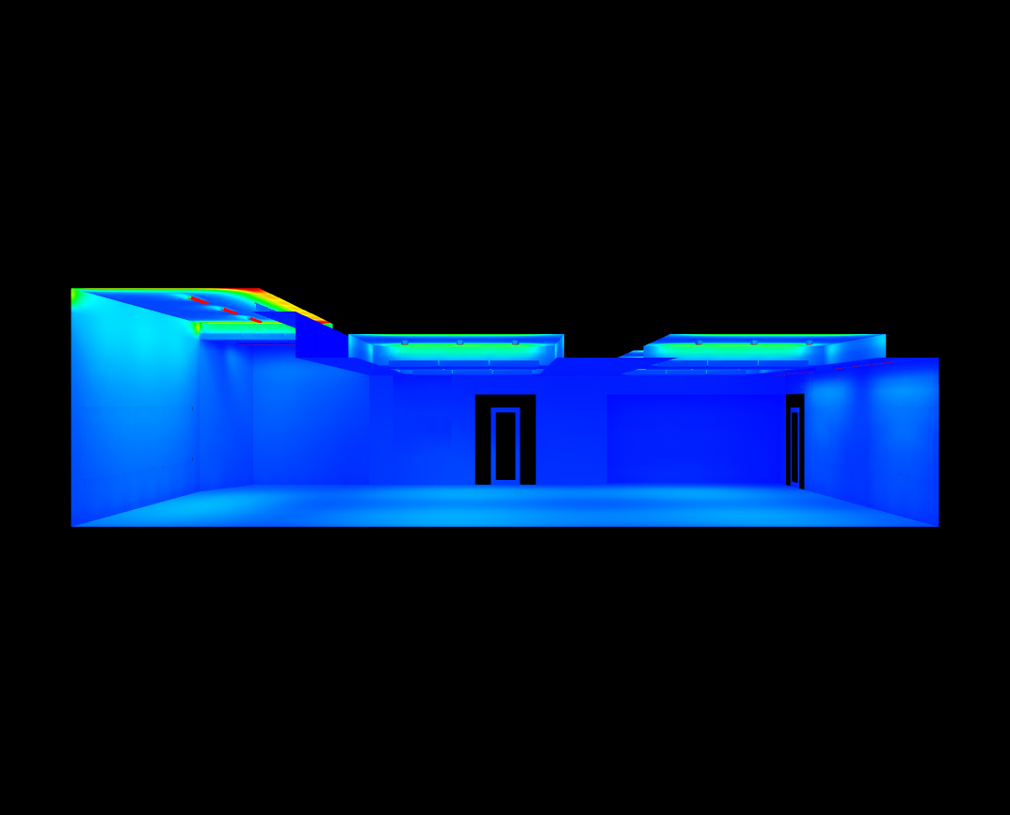
MIT Koch Institute for Integrative Cancer Research
Building Overview
Lighting Depth & Electrical Depth – Redesign
-Streetscape
-Gallery
-Flex Use Space
-Laboratory
Architectural Breadth– Southern façade shading
Electrical Depth – Copper/Aluminum feeder study

Slide 34
MIT Koch Institute for Integrative Cancer Research
Building Overview
Lighting Depth & Electrical Depth – Redesign
-Streetscape
-Gallery
-Flex Use Space
-Laboratory
Architectural Breadth– Southern façade shading
Electrical Depth – Copper/Aluminum feeder study
Performance:
  Illuminance
    Lecture/Conference
      Horizontal: 19.31 fc avg
      Vertical: 7.6 fc avg
    Social
      Horizontal: 11.1 fc avg
      Vertical: 4.45 fc avg
  Lighting Power Density
    Allowed power = 3295.5 W
    Design power = 3302.8 W

Slide 35
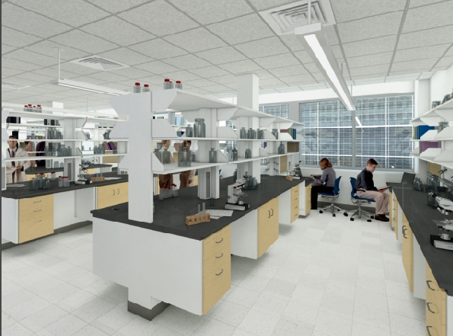
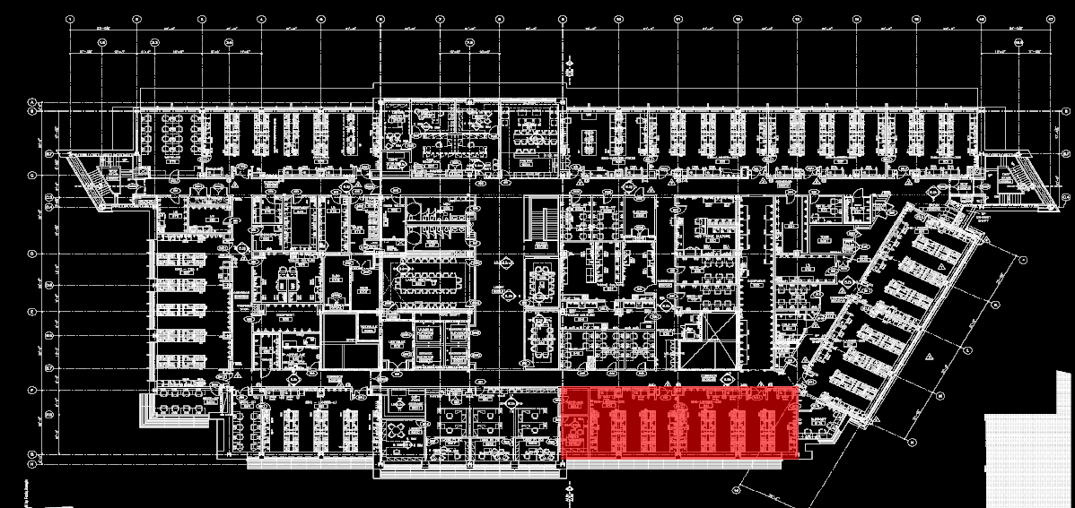
MIT Koch Institute for Integrative Cancer Research
Building Overview
Lighting Depth & Electrical Depth – Redesign
-Streetscape
-Gallery
-Flex Use Space
-Laboratory
Architectural Breadth– Southern façade shading
Electrical Depth – Copper/Aluminum feeder study
Rendering from the architect, EllenZweig

Slide 36
MIT Koch Institute for Integrative Cancer Research
Building Overview
Lighting Depth & Electrical Depth – Redesign
-Streetscape
-Gallery
-Flex Use Space
-Laboratory
Architectural Breadth– Southern façade shading
Electrical Depth – Copper/Aluminum feeder study
Goals:
  Create a task-ambient lighting environment
  Provide controls to automatically and manually adjust lighting for optimal energy savings

Slide 37
MIT Koch Institute for Integrative Cancer Research
Building Overview
Lighting Depth & Electrical Depth – Redesign
-Streetscape
-Gallery
-Flex Use Space
-Laboratory
Architectural Breadth– Southern façade shading
Electrical Depth – Copper/Aluminum feeder study
Goals:
  Create a task-ambient lighting environment
  Provide controls to automatically and manually adjust lighting for optimal energy savings

Slide 38
MIT Koch Institute for Integrative Cancer Research
Building Overview
Lighting Depth & Electrical Depth – Redesign
-Streetscape
-Gallery
-Flex Use Space
-Laboratory
Architectural Breadth– Southern façade shading
Electrical Depth – Copper/Aluminum feeder study
Criteria:
  Illuminance
    Horizontal: 50 fc
    Vertical: 30 fc
  Lighting Power Density
    1.4 W/ft²

Slide 39
MIT Koch Institute for Integrative Cancer Research
Building Overview
Lighting Depth & Electrical Depth – Redesign
-Streetscape
-Gallery
-Flex Use Space
-Laboratory
Architectural Breadth– Southern façade shading
Electrical Depth – Copper/Aluminum feeder study
Criteria:
  Illuminance
    Horizontal: 50 fc
    Vertical: 30 fc
  Lighting Power Density
    1.4 W/ft²
Dimensions:
  ~ 1940 ft²
  ~ 23’-1” x 72’-10”
  Height = 11’-3”

Slide 40
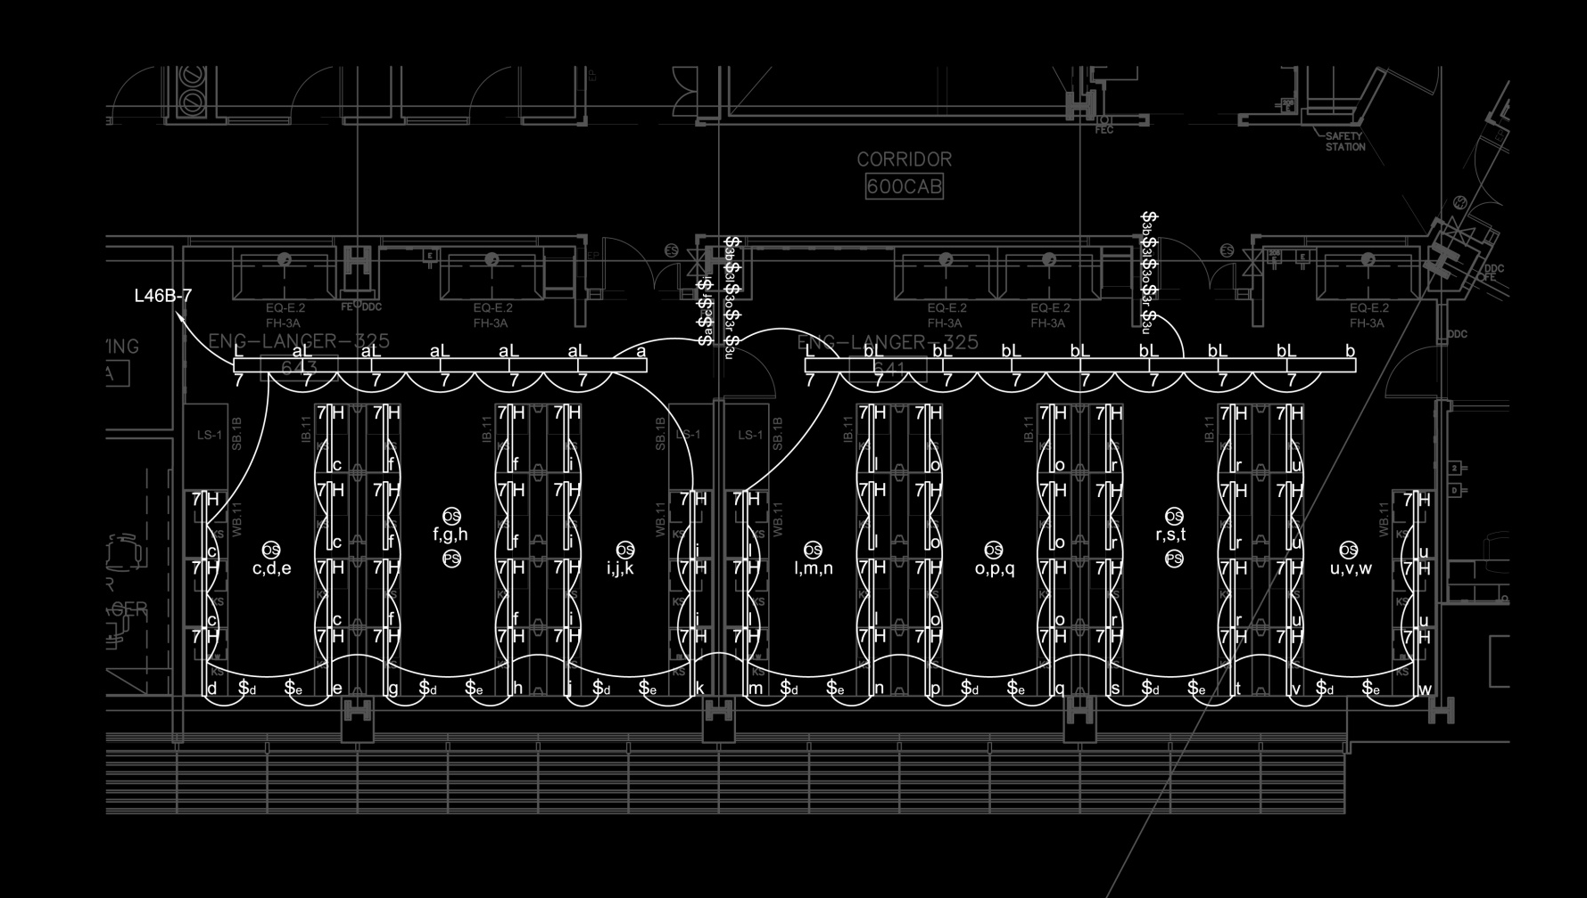
MIT Koch Institute for Integrative Cancer Research
Building Overview
Lighting Depth & Electrical Depth – Redesign
-Streetscape
-Gallery
-Flex Use Space
-Laboratory
Architectural Breadth– Southern façade shading
Electrical Depth – Copper/Aluminum feeder study
Dimensions:
  ~ 1940 ft²
  ~ 23’-1” x 72’-10”
  Height = 11’-3”

Slide 41
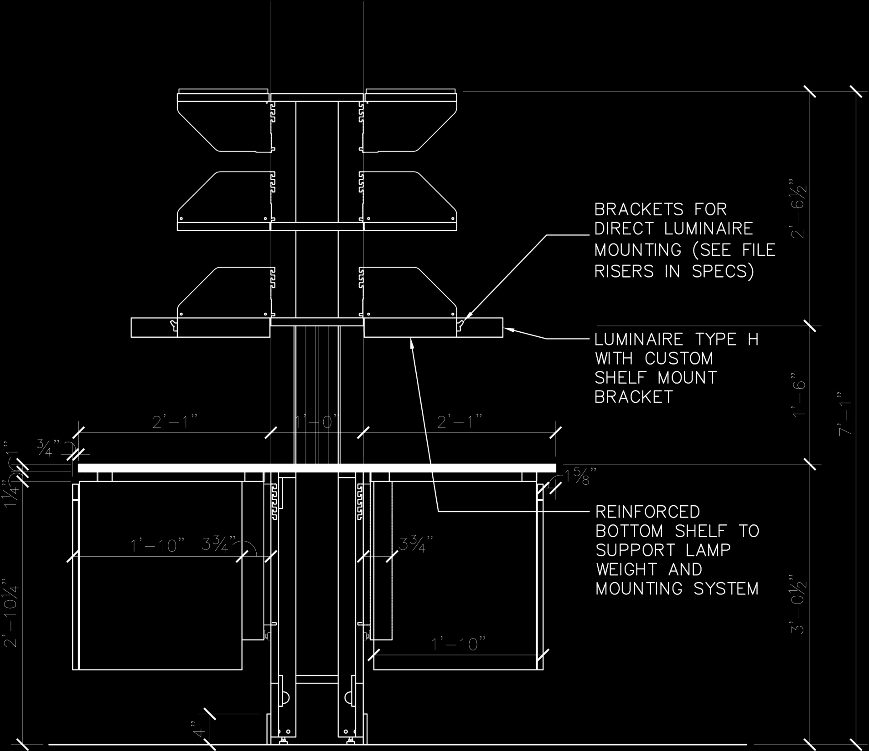
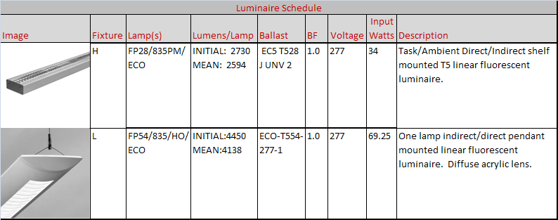
MIT Koch Institute for Integrative Cancer Research
Building Overview
Lighting Depth & Electrical Depth – Redesign
-Streetscape
-Gallery
-Flex Use Space
-Laboratory
Architectural Breadth– Southern façade shading
Electrical Depth – Copper/Aluminum feeder study

Slide 42
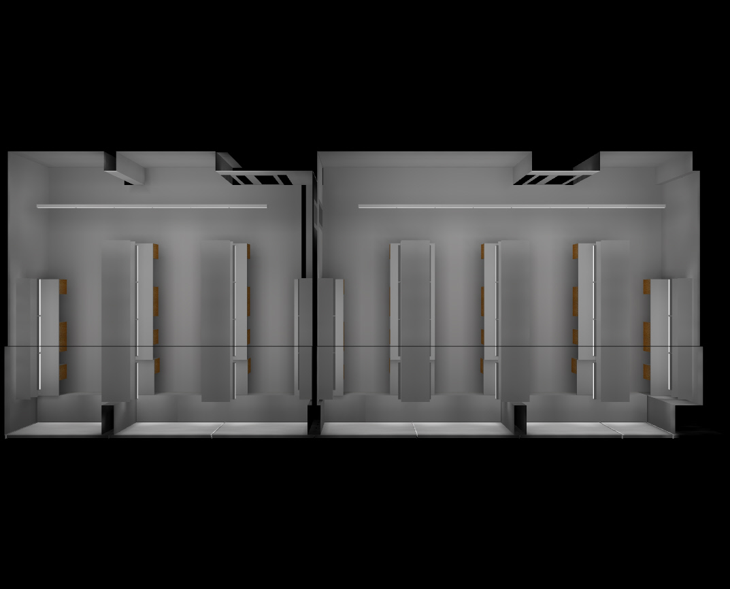
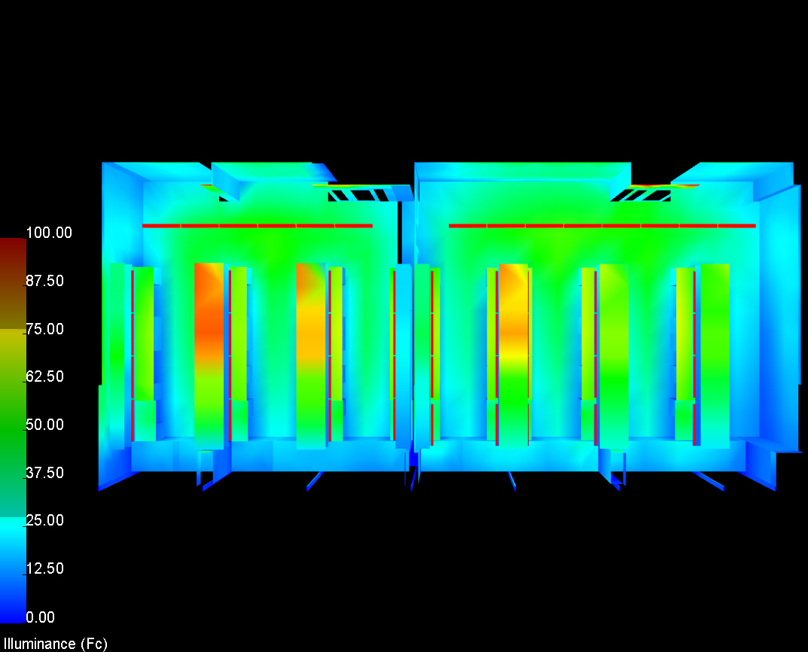
MIT Koch Institute for Integrative Cancer Research
Building Overview
Lighting Depth & Electrical Depth – Redesign
-Streetscape
-Gallery
-Flex Use Space
-Laboratory
Architectural Breadth– Southern façade shading
Electrical Depth – Copper/Aluminum feeder study

Slide 43
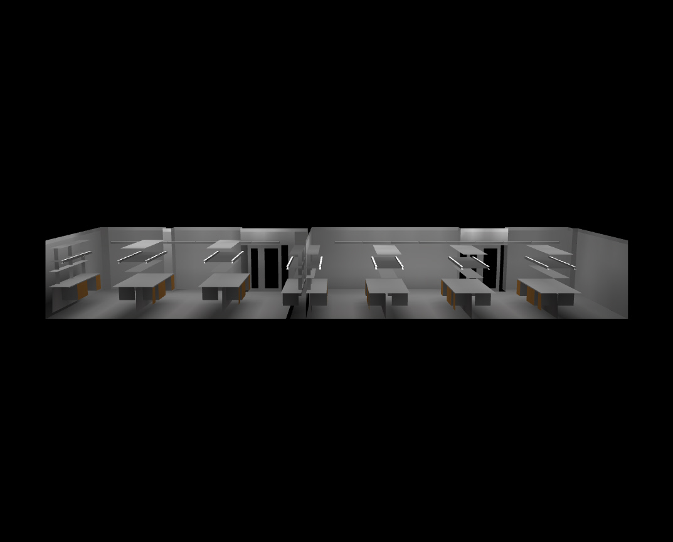
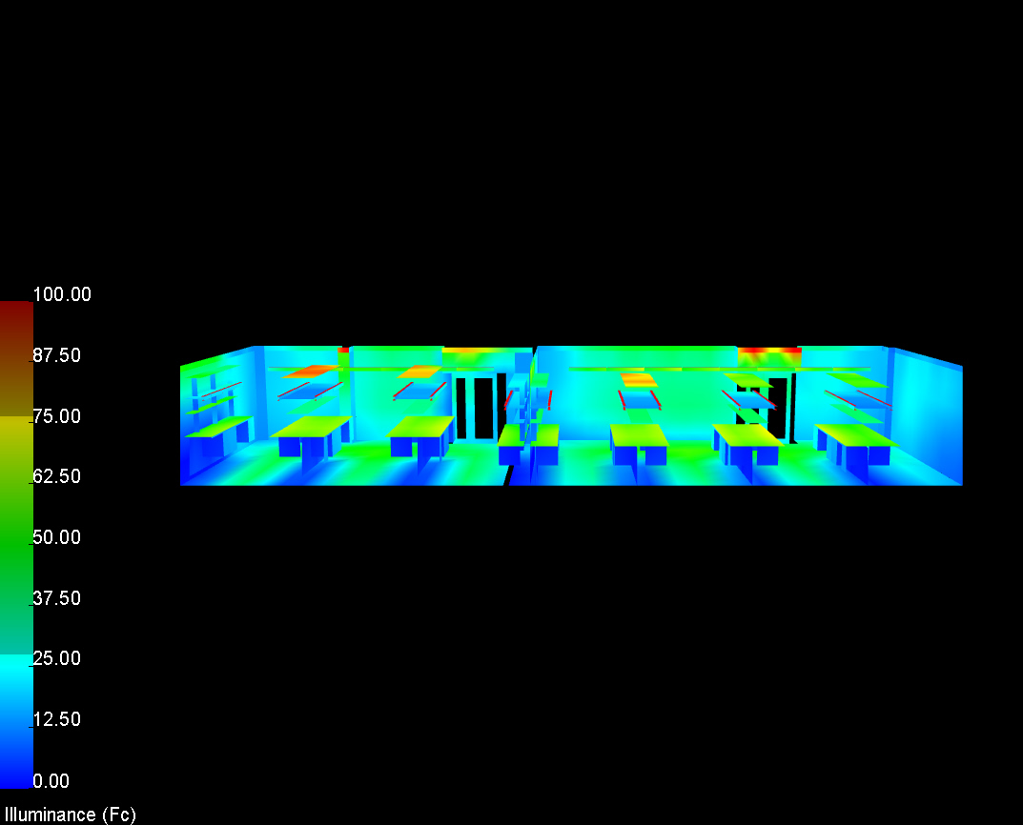
MIT Koch Institute for Integrative Cancer Research
Building Overview
Lighting Depth & Electrical Depth – Redesign
-Streetscape
-Gallery
-Flex Use Space
-Laboratory
Architectural Breadth– Southern façade shading
Electrical Depth – Copper/Aluminum feeder study

Slide 44
MIT Koch Institute for Integrative Cancer Research
Building Overview
Lighting Depth & Electrical Depth – Redesign
-Streetscape
-Gallery
-Flex Use Space
-Laboratory
Architectural Breadth– Southern façade shading
Electrical Depth – Copper/Aluminum feeder study
Performance:
  Illuminance
    Horizontal - Desk: 40.37 fc avg
    Horizontal – Bench: 51.85 fc avg
    Horizontal – Floor: 44.37 fc avg
    Vertical: 37.47 fc average
  Lighting Power Density
    Allowed power = 2716 W
    Design power = 2737.5 W

Slide 45
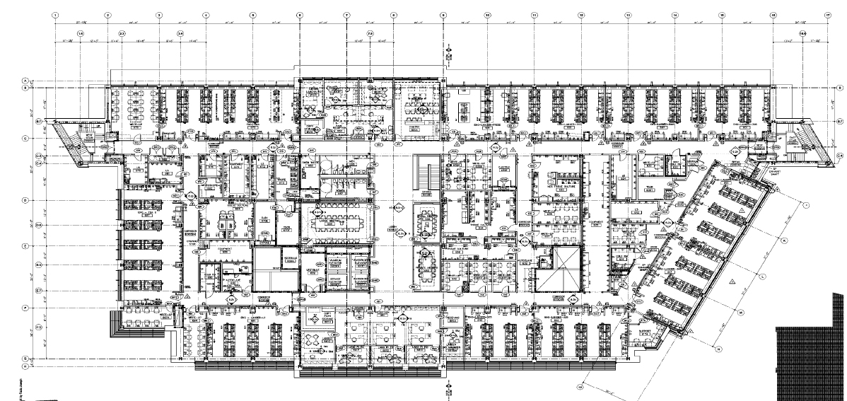
MIT Koch Institute for Integrative Cancer Research
Building Overview
Lighting Depth & Electrical Depth – Redesign
-Streetscape
-Gallery
-Flex Use Space
-Laboratory
Architectural Breadth– Southern façade shading
Electrical Depth – Copper/Aluminum feeder study

Slide 46

MIT Koch Institute for Integrative Cancer Research
Building Overview
Lighting Depth & Electrical Depth – Redesign
-Streetscape
-Gallery
-Flex Use Space
-Laboratory
Architectural Breadth– Southern façade shading
Electrical Depth – Copper/Aluminum feeder study

Slide 47


MIT Koch Institute for Integrative Cancer Research
Building Overview
Lighting Depth & Electrical Depth – Redesign
-Streetscape
-Gallery
-Flex Use Space
-Laboratory
Architectural Breadth– Southern façade shading
Electrical Depth – Copper/Aluminum feeder study

Slide 48
MIT Koch Institute for Integrative Cancer Research
Acknowledgements:
  Dr. Richard Mistrick – Advisor
  Mr. Theodore Dannerth - Advisor
  Dr. Kevin Houser
  Ron Achin – BR+A Consulting Engineers, LLC
  Domenico Sinopoli – BR+A Consulting Engineers, LLC
  Bryan Rydingsward – BR+A Consulting Engineers, LLC
  Arne Abramson – MIT Department of Facilities
  Peter Cooper – MIT Department of Facilities
  All my friends and family
  My dog Val for not destroying my room while I was in the lab

